Slide 1
Chapter 1
Biology

Slide 2
QUIZ
What is Biology?
What is Science?
What are the 4 branches of Science?

Slide 3
ANSWERS
Biology-
the study of life

Slide 4
ANSWERS
Science-
Webster’s Dictionary- systematic knowledge of natural or physical phenomena; truth obtained by observation, experiment, and induction
Winters’-
the study of why something occurs or exists
What? How? Why?

Slide 5
ANSWERS
4 branches of Science
1.
2.
3.
4.
*Hopewell Curriculum

Slide 6
Why do I need to know about Biology?
We are living
The more you know about biology, the more you will understand yourself.
  Diets (Adkins, Hollywood), pains (bees), foods

Slide 7
Ask Questions????
Understand the world around you.
  Plastic?
  Tapioca?
  Nylon?
  Caviar?
  Jello?
  Pig intestines are used for what?

Slide 8
How is Biology used in your everyday life?
List examples and briefly explain.
  Feeding the dog- what to eat, amount, how often
  Toilet paper- gets the job done, breaks down in water

Slide 9
Will Biologists answer all questions?
We will never run out of questions.
We are finding new organisms
We will never cure all diseases or feed all people
We do not have an endless supply of energy (oil)

Slide 10
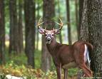
Living things must interact with environment
Deer example:
What might determine how many deer can live in an area?

Slide 11
Characteristics of living things
Organization
Reproduction
Growth and Development
Adaptation
Homeostasis

Slide 12
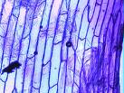
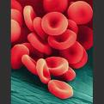
Organization
Composed of one or more cells

Slide 13

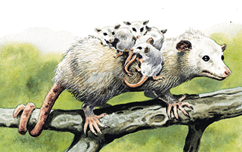

Reproduction
Organisms must replace themselves
  Species- group of organisms that interbreed and produce fertile offspring
  Which animal cannot reproduce?
  Subspecies?

Slide 14
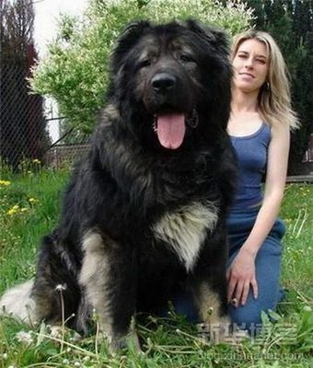
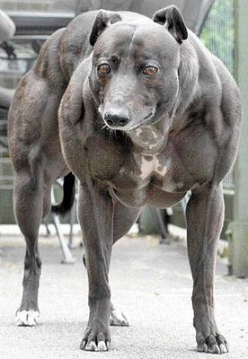
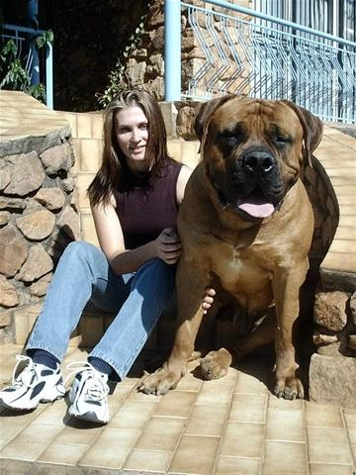
Growth and Development
Growth- increase in amount of living material
Development- changes during life (mature)

Slide 15

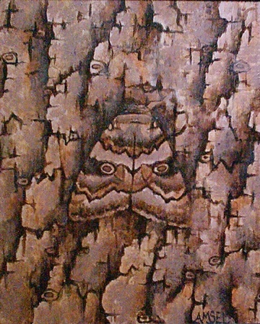
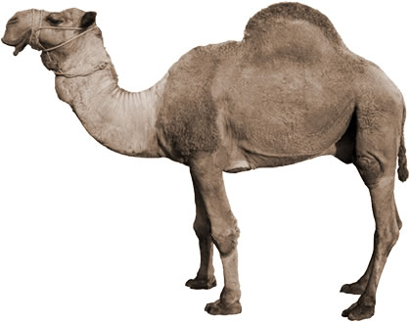
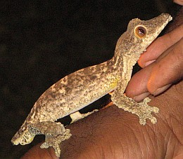
Adaptation
Respond to a stimulus
  Stimulus- condition
  Response- reaction to a stimulus
  Examples:
  Eyes adjust to light
  Camels store water

Slide 16
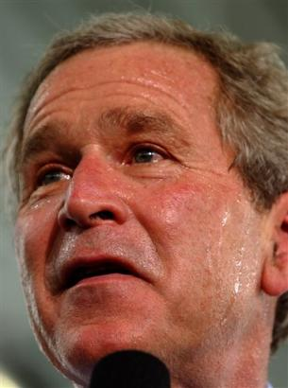
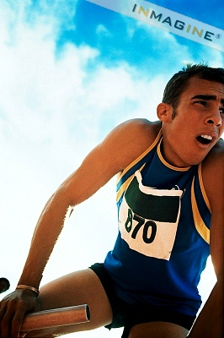
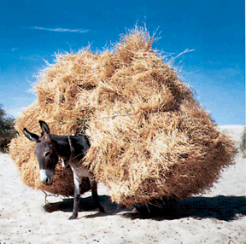
Homeostasis
Regulation of internal environment (int. adaptation)
Examples:
Waste, salt, water, sugar, temperature, oxygen

Slide 17
Organization
Levels of Organization
  Atom
  Molecule
  Organelle
  Cell
  Tissue
  Organ
  Organ System
  Multicellular Organism

Slide 18
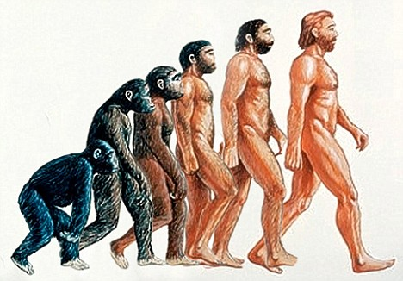
Evolution
Gradual change in a population of species over time in order to survive and compete for mates.
Ex: Deer(brown/white), camo, lizards, man-eaters
Are humans still evolving?

Slide 19
1.2 Methods in Biology
Why does rain bring out worms?
Why does moss grow on the north side of a tree?
Which side of a mountain are most ski slopes?

Slide 20
Scientific Methods
Steps used to gather information and answer questions
Define Problem
Hypothesis
Experiment
Analyze Data
Report Results

Slide 21
Define Problem
What are you trying to answer?
Observation-
  Information collected from the 5 senses
  Observation QUIZ!

Slide 22
Hypothesis
Testable explanation for a problem
  Not an opinion
  Often “if…then” statements
Example: If batteries last longer, then that brand costs more money.

Slide 23
Hypothesis- “Reasoning”
Inductive Reasoning- using a fact and apply to all
Ex: Mr. Allison
Deductive Reasoning- use a general rule and apply to a specific case
Ex: Doctor

Slide 24
Experiment
Testing a hypothesis under controlled conditions
Control- condition kept the same
Control Group?
Independent variable- condition changed
Dependent variable- measurement of the change in the ind. variable
Data- information collected (# or description)

Slide 25
Experiment examples
Batteries
  Independent Variable , Dependent Var., Control
Testing Shoes
Weight-loss pills
  Placebo?
Ginko Biloba Worksheet

Slide 26
Scientific Method
Analyzing Data:
  Did the experiment answer the problem?
  Is more experimenting needed?
  Reporting Results:
  Was your hypothesis correct? Why or why not?
  Show results (Chart and Graphs)

Slide 27
Scientific Method
Theory- explanation supported by scientific evidence
Law- Fact of nature, cannot be disproven

Slide 28
1.3 The Nature of Biology
Quantitative- results in numerical data
- reported as tables or graphs
- English / Customary vs. SI / Metric
- based on ten, easy to convert
Qualitative- results in observational data

Slide 29
Ethics- moral principles or values
Science is not good or bad
Some applications may be viewed as good or bad
Stem cell research, cloning, abortion, death penalty
Stem cell link
Stem cell link 2
Stem cell link 3

Slide 30
Science
Pure Science
- study carried out for the sake of knowledge
- no immediate impact to humans
Ex: Pluto being a planet
Jellyfish glow in florescent light

Slide 31
Science
Technology
- application of science to improve human life
Ex: protein code to promote cells to grow hair
increase food production
reduce manual labor
decrease pollution
alternative sources of energy

Slide 32
Is our technology allowing us to live too long?

