Slide 1
Chapter 10
Genetics

Slide 2
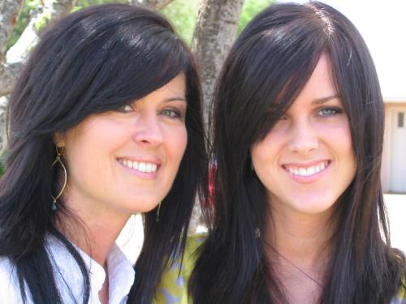
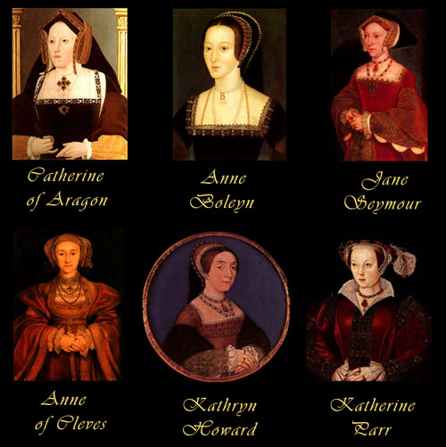
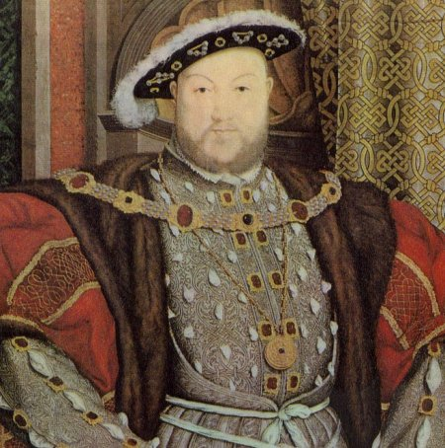
Genetics
Why do offspring resemble
parents?
Why did Henry VIII kill his wives?

Slide 3
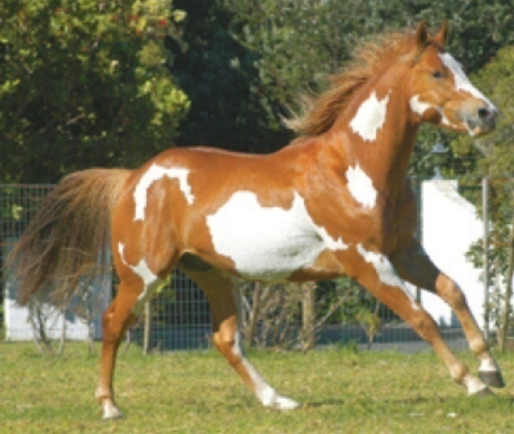
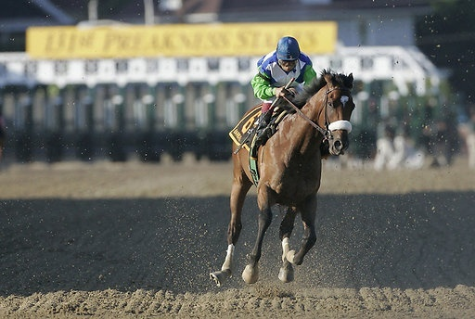
Why are purebreds so expensive?
Controlled Mating
  Dogs (AKC, good senses, diseases)
  Paint horse
Why was “Barbaro” a big deal?
  Earned $3 Million racing
  A.P. Indy- (sire: Seattle Slew 1977HOY)
    1992 Horse of year / $250,000 stud fee x 90
    Over $22,000,000 per year
    Rachel Alexandria / Mine that Bird

Slide 4
Why are you the way you are?
NATURE
Genetics
Heredity / Genes
Alcoholism
Lifting weights
Size (weight / height)
NURTURE
Environment
Learned / Choice
Success
Athletic ability
Sexuality

Slide 5
10.1 Mendel’s Law of Heredity
Gregor Mendel (1800s) - Father of Genetics
  Austrian monk
  Used garden peas
    Reproduced sexually
    Both gametes on a single flower
    Stamen (male) Pistil (female)
    Fertilization vs. Pollination

Slide 6
Monohybrid Cross
Parents differ by one trait
  Ex: Pea color and height, tongue-roller, lobed ears
P1 (parent generation) tall plants x dwarf
F1 (Filial generation) all tall plants
F2 3 tall: 1 dwarf
Phenotype- trait expressed
Allele- represents a gene passed from each parent

Slide 7
Monohybrid Cross
Genotype- allele combination from parents
P1 TT x tt
F1 Tt
F2 1 TT : 2 Tt : 1 tt (Genotypes)
3 tall : 1 dwarf (Phenotypes)
Homozygous vs. Heterozygous
Dominant- allele causes phenotype when present
Recessive- allele only expressed when no dominants

Slide 8
Determining Alleles
If two true breeding plants are crosses, the allele determining the phenotype is dominant.
TT (tall) x tt (dwarf)
Tt (tall)
Symbol for allele = dominant allele’s first letter
Ex: Tall/Dwarf, Lobed/ Attached, Round/Wrinkled

Slide 9
Punnett Squares
Determines the proportions of possible genotypes of offspring.
Parent: TT, Tt, tt
What offspring will result in a cross of a homozygous recessive plant with a heterozygous plant?

Slide 10
Problems
If round peas are dominant over wrinkled peas, determine the offspring of a cross between round peas that are heterozygous.
Cross two wrinkled peas?

Slide 11
Pedigree
Constructing a Pedigree:
  Rules:
    Females are circles
    Males are squares
  Begin with your parents
    Connect them with a mating line
    Offspring line / Generations / Multiple mates
    Unknown/ Label

Slide 12
Using Punnett Squares Worksheet
Silkworms Parents: CC x cc
C- yellow cocoon
c- white cocoon
Genotype:
Phenotype:

Slide 13
Using Punnett Squares Worksheet
Guinea Pigs Parents: Ff x ff
F- short fur
f- long fur
Genotype:
Phenotype:

Slide 14
Using Punnett Squares Worksheet
Mice Parents: Ee x Ee
E- black eyes
e- red eyes
Genotype:
Phenotype:

Slide 15
Using Punnett Squares Worksheet
Four o’clock plants Parents: white x pink
F- red
f- white
Ff- pink
Genotype:
Phenotype:
Co-dominance

Slide 16
Dihybrid Cross
Two Traits
T- tall , t- dwarf (height)
R- round, r- wrinkled (seed coat)
TTRR x ttrr
F1?
F2?
Questions on the back of pedigree directions

Slide 17
Dihybrid Cross

Slide 18
Types of Dominance
Complete Dominance
  One gene controls a trait
  Heterozygote shows dominant trait (identical)
Incomplete Dominance
  One gene
  Heterozygote shows intermediate trait
  4 o’clocks

Slide 19
Types of Dominance
Multiple Gene Inheritance
  More than one gene controls one trait
  Skin color (6 genes)
  AABBCCDDEEFF x aabbccddeeff

Slide 20
Types of Dominance
Co-dominance
  Blood Types

Slide 21
Types of Dominance
Sex-Linked Recessive (X-linked)
  Expressed when all “X” chromosomes contain the affected gene
  Female- XX Male- XY
  Females usually have an unaffected X to cover

Slide 22
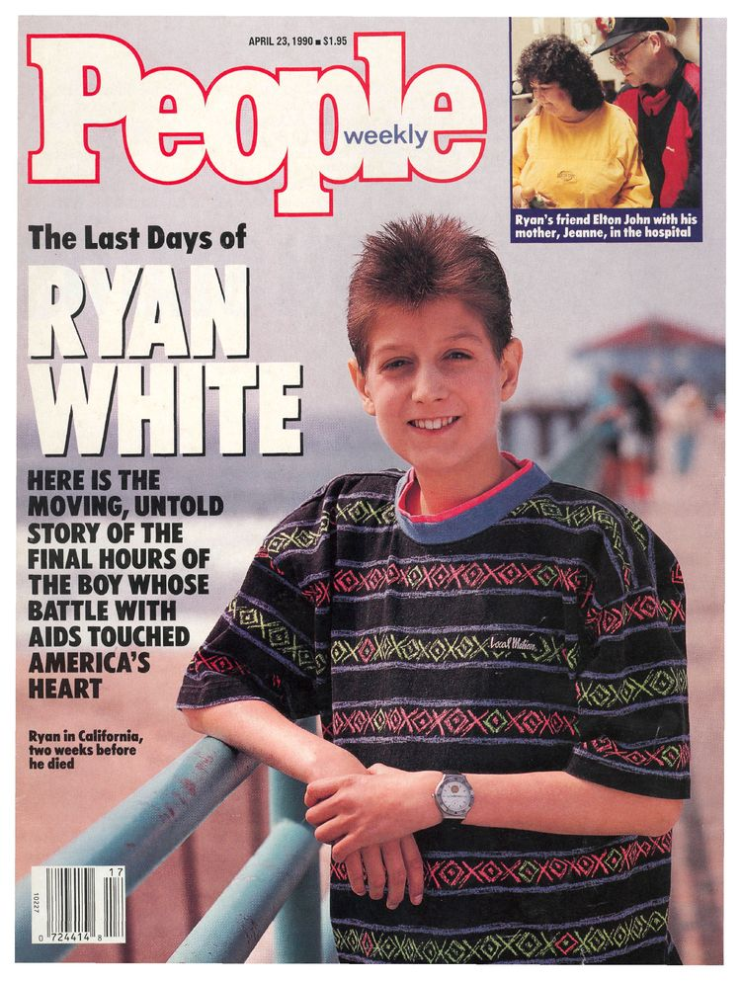
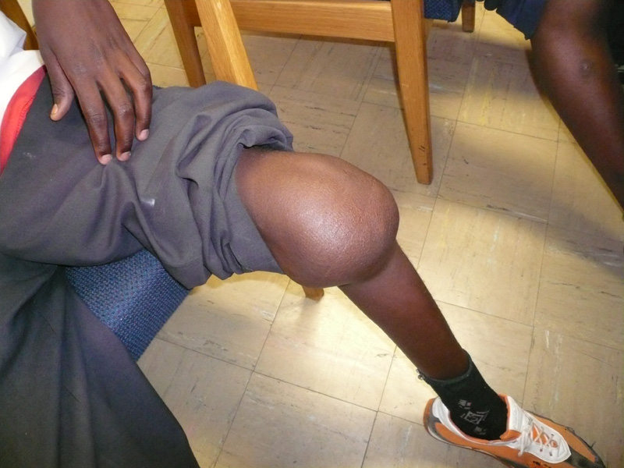
Sex-linked Recessive Examples
  Hemophilia
    Blood will not clot

Slide 23
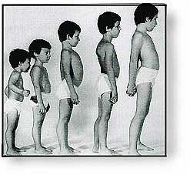
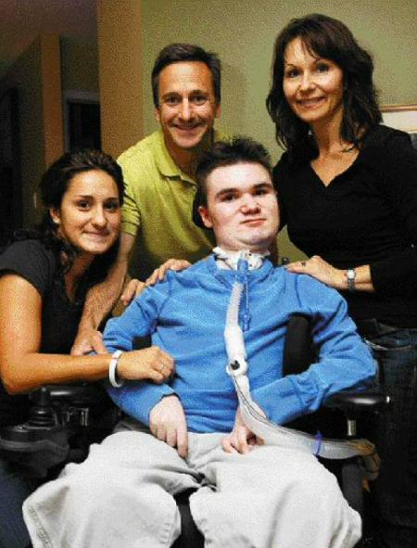
Sex-linked Recessive Examples
  Duchenne Muscular Dystrophy
    Mom is a carrier, X_{md}X

Slide 24
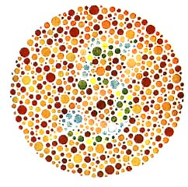
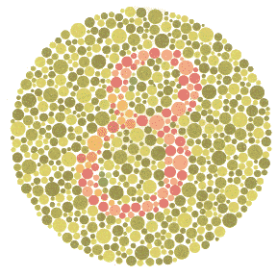
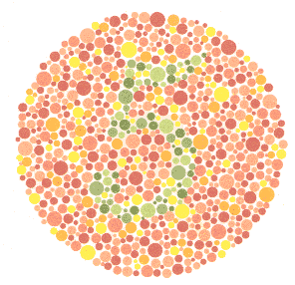
Sex-linked Recessive Examples
  Red/Green Color Blindness

Slide 25
Non-Disjunction
Meiosis 46→23 does not happen correctly

