Slide 1
6.3 Life Substances

Slide 2
Role of Carbon (organic)
4 electrons available / 4 covalent bonds
May form straight chains, branched, rings
Isomers- compounds with the same formula but different 3D structures
Glucose Fructose
C₆H₁₂O₆

Slide 3
Carbon Compounds
One atom → Thousands of atoms
(methane) (starch)
Polymers- long chain of bonded molecules

Slide 4
Types of Organic Compounds
Carbohydrates
Lipids
Proteins
Nucleic Acids

Slide 5
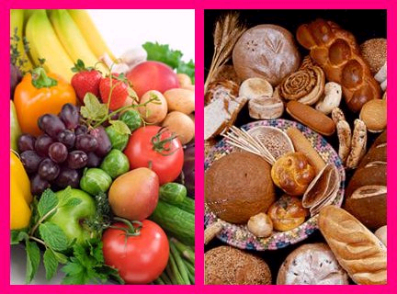
Carbohydrates
Organic compound
composed of C,H,O
Ratio of 2 Hydrogen to each O and C
Ex: C₆H₁₂O₆ and C₅H₁₀O₅ and C₁₁H?O₁₁

Slide 6

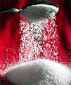
Carbohydrates
Monosaccharide- single sugar
Ex: glucose and fructose- C₆H₁₂O₆
Disaccharide- two single sugars linked
Ex: glucose + fructose → Sucrose + H₂O

Slide 7
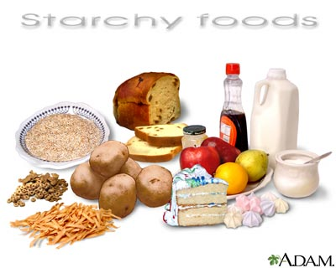
Carbohydrates
Polysaccharides- polymer of monosaccharides
1. Starch- branched chains of glucose
- food storage in plants

Slide 8

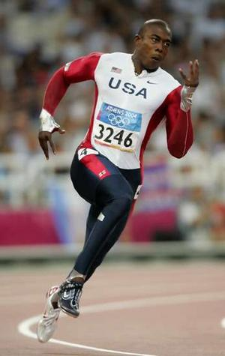
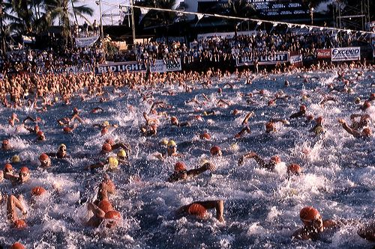
Polysaccharides
2. Glycogen- animals store in muscles

Slide 9
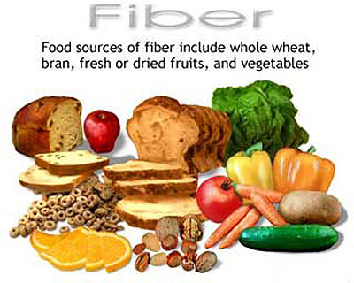
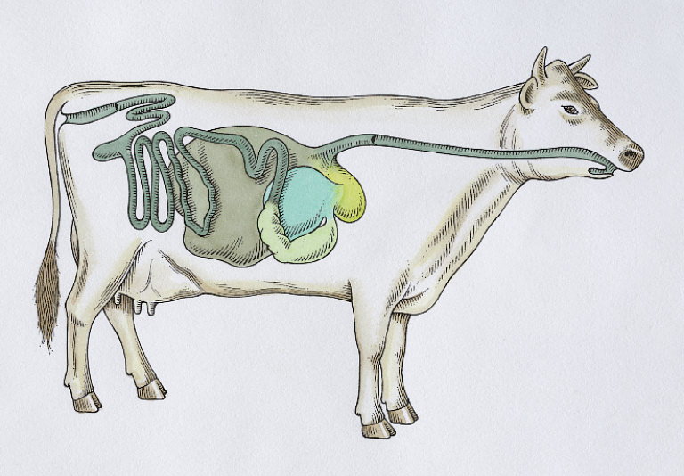
Polysaccharides
3. Cellulose- glucose polymer forming cell walls of plants
Humans Cows- bacteria

Slide 10
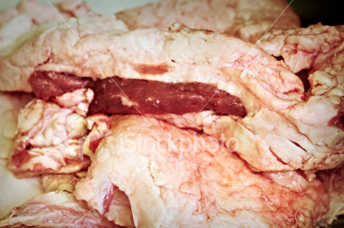
Lipids (Fats and Oils)
Large proportions of C-H bonds and less O
C₅₇ H₁₁₀O₆ – Beef fat
Nonpolar and repel water (Hydrophobic)
Not soluble in water

Slide 11
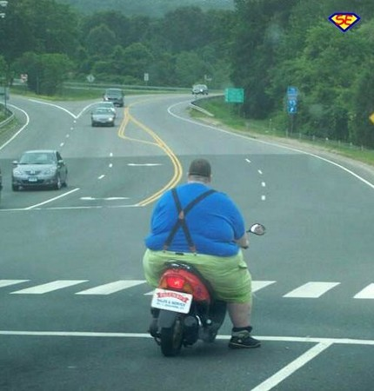
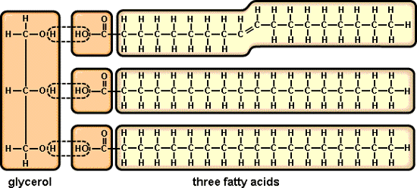
Lipids (Fats and Oils)
Uses of Lipids
  Energy Storage
  Insulation
  Protective coatings
Triglyceride- most common lipid
  Glycerol + 3 fatty acids
  Used to determine fat in blood

Slide 12
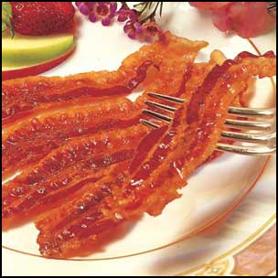
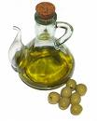
Lipids
Two types of Fats:
  Saturated
  Unsaturated
Which type is worse?
How can you tell the difference?
Saturated fat is a solid at room temperature

Slide 13
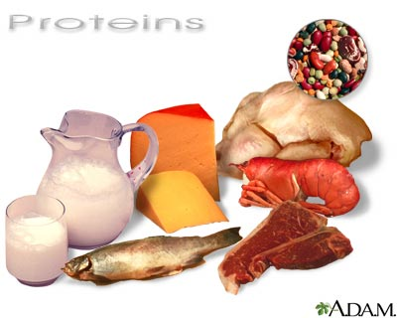
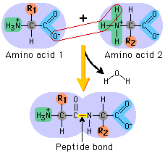
Protein
Consists of C,H,O,N, and sometimes S
Amino Acids are the building blocks of protein
→20 amino acids
Peptide bonds hold amino acids together

Slide 14

Importance of Protein
Muscle contraction
Transporting oxygen
Immune system
Chemical reactions (metabolism)
  Enzymes- speed up chemical reactions
  Aid in digestion of foods (lactose intolerant)

Slide 15
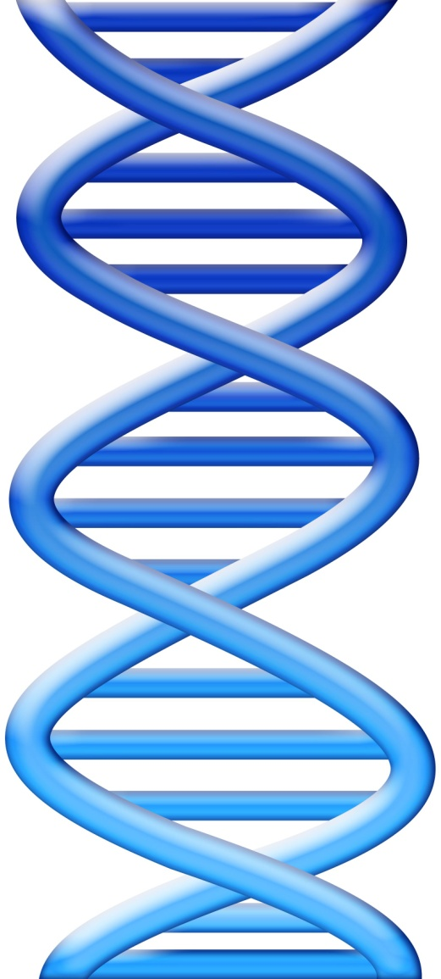
Nucleic Acids
Complex molecules that store information in cells in the form of a code
Subunits are nucleotides
  Consist of C,H,O,N,P
  Contain 3 parts:
  1. Nitrogen base
  2. Sugar
  3. Phosphate group

Slide 16
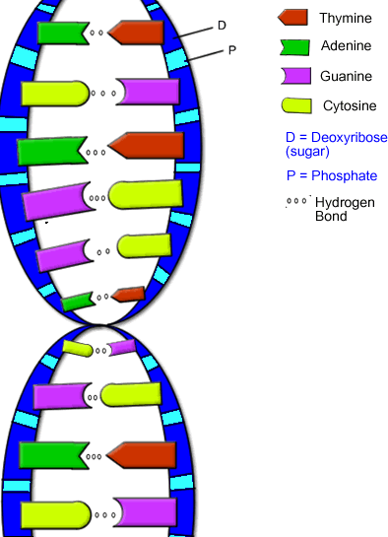
Nucleic Acids
DNA- Deoxyribonucleic Acid
RNA- Ribonucleic Acid
Only difference is the sugar
  DNA- Deoxyribose
  RNA- Ribose
Melanin Production

