Slide 1
Open House 2015
Keys to Success

Slide 2
Keys to Success
Academic
Stay connected
Monitor Homework
NWEA/RTII
Social
OLWEUS/7 Habits of Highly Effective Teens
Social Media

Slide 3
NWEA – Map Testing
3 times a year
Shows student strengths and areas of need
Shows student growth
Used in grades 5/6 for RTII time during study halls
PSSAs
What do your child’s scores mean?

Slide 4
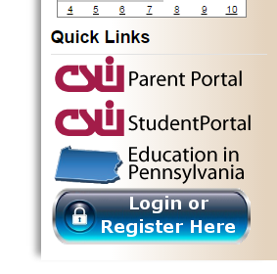
Get Connected
Check our school website for news and information
http://www.hopewell.k12.pa.us/hopewelljuniorhighschool_home.aspx
Sign up for Email and Text alerts here
Grades are available through

Slide 5
Homework – How to Help
Checklist for helping your child with homework:
Show that you think education and homework are important.
Set a regular time/place for homework.
Remove distractions.
Provide supplies and identify resources.
Set a good example.
Be interested:
Monitor assignments.
Know the school’s homework policies and philosophy.
Be available.
Look over completed assignments.
Monitor time spent viewing television and playing video games.
Help your child get organized.

Slide 6
OLWEUS
The goals of the program are:
to reduce existing bullying problems among students
to prevent the development of new bullying problems
to achieve better peer relations at school

Slide 7
OLWEUS Is it bullying, real fighting or rough play?
Rough Play | Real Fighting | Bullying
Usually friends | Usually not friends | Typically not friends, generally repeated
Equal balance of power | Equal balance of power | Unequal balance of power
No Intent to harm | Intentional harm-doing | Intentional harm-doing
Mood is friendly; positive; mutual | Mood is negative, aggressive, tense | Mood is negative; mood/response differs for victim and aggressor

Slide 8
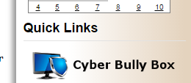
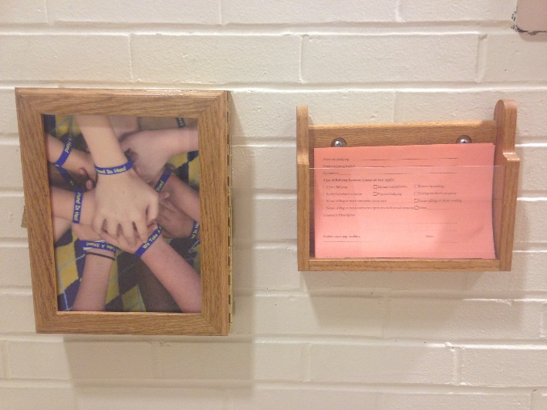
Incidences of Bullying
How should students/parents report concerns?
Call your school counselor
Use the school bully box
Use the cyber bully box
http://www.hopewell.k12.pa.us/CyberBullyBox1.aspx

Slide 9
7 Habits of Highly Effective Teens
https://www.youtube.com/watch?v=GrLsG2GrrmA&feature=youtu.be

Slide 10
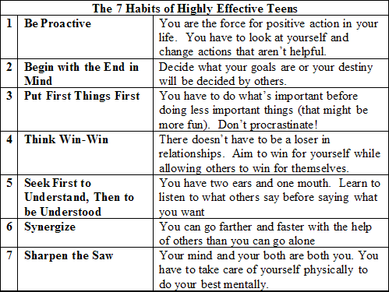

Slide 11
Social Media

